Slide 1
Big Mountain Ticket Price
Dina Batros

Slide 2
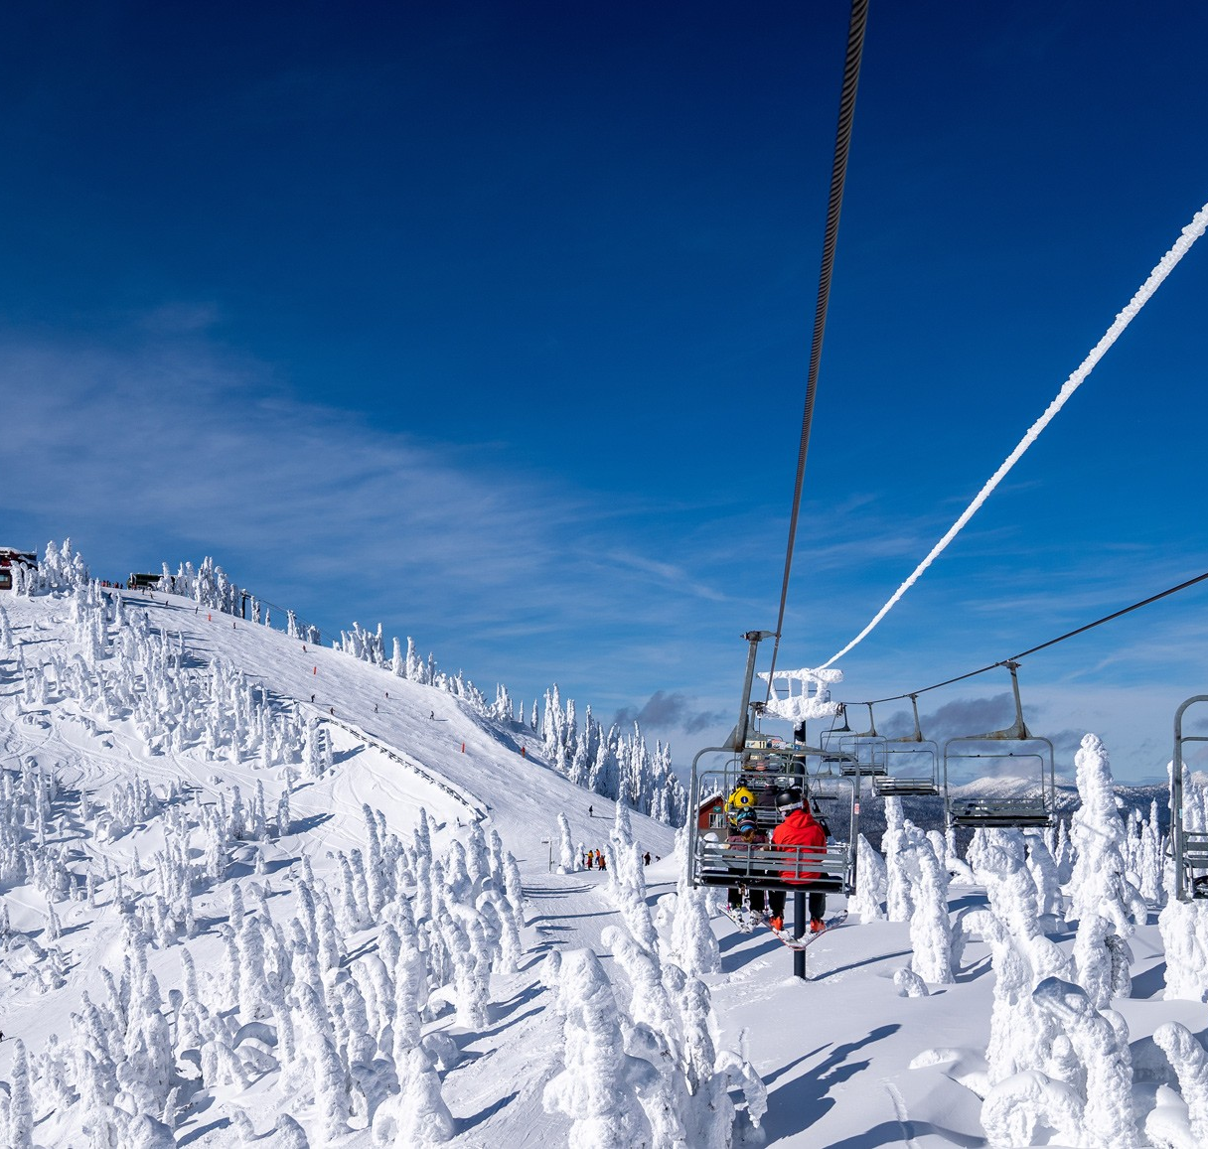
Agenda
Problem
Key Findings
Model & Analysis
Recommendations

Slide 3
Introduction
Big Mountain Resort offers spectacular views of Glacier National Park and Flathead National Forest, with access to 105 trails. Every year about 350,000 people ski or snowboard at Big Mountain. This mountain can accommodate skiers and riders of all levels and abilities. These are serviced by 11 lifts, 2 T-bars, and 1 magic carpet for novice skiers. The longest run is named Hellfire and is 3.3 miles in length. The base elevation is 4,464 ft, and the summit is 6,817 ft with a vertical drop of 2,353 ft. Big Mountain Resort has recently installed an additional chair lift to help increase the distribution of visitors across the mountain. This additional chair increases their operating costs by $1.54M this season. The resort's pricing strategy has been to charge a premium above the average price of resorts in its market segment.

Slide 4
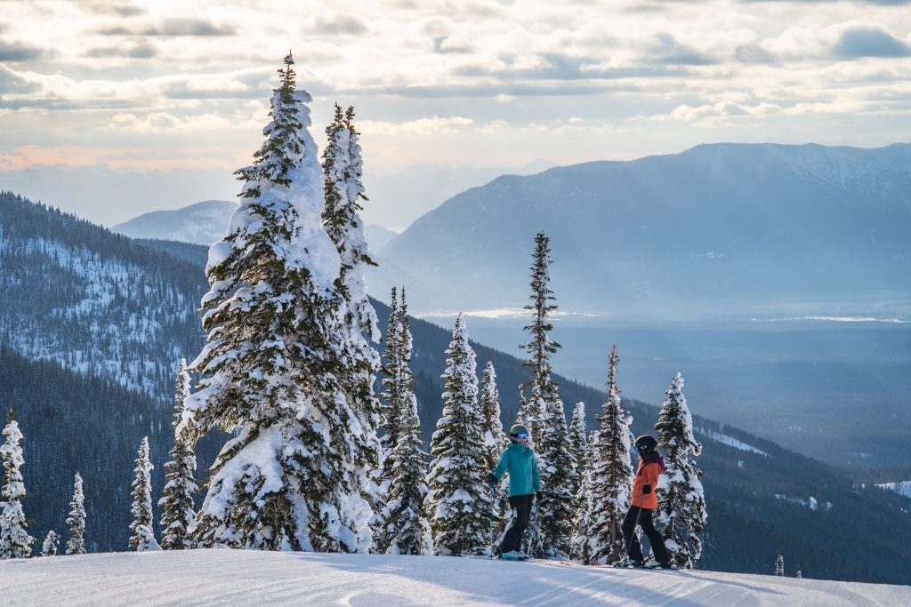
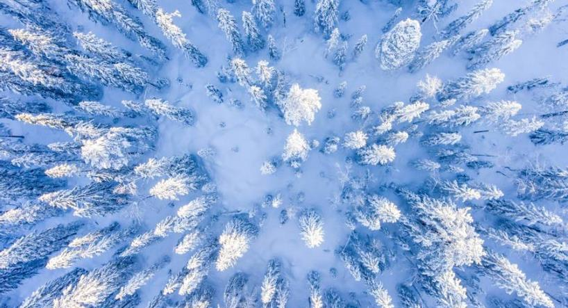
Problem
New Chair lift: increases the operation cost to $1.54 million.
How do we increase the revenue and stay at the top of what we offer in the new upcoming season?

Slide 5
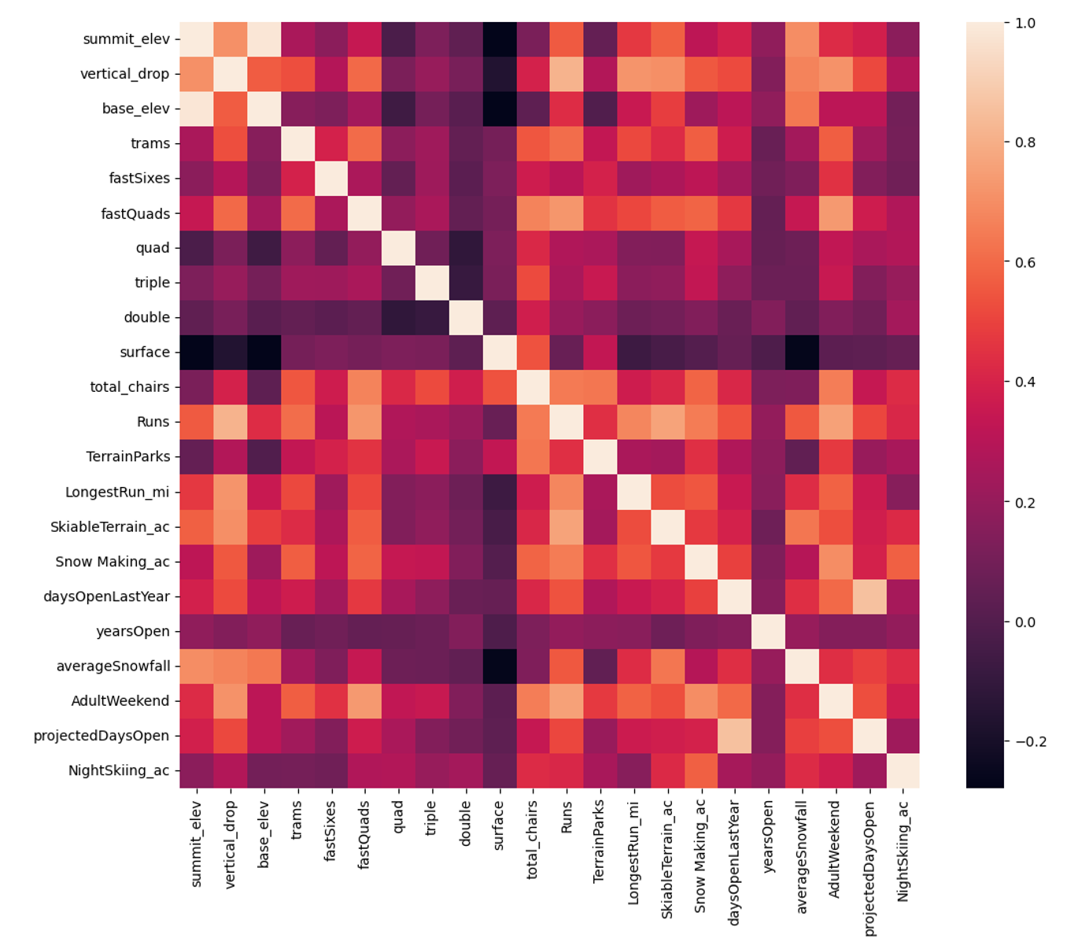
Key Findings & Recommendations
Close up to 10 of the least used runs.
Increase the vertical drop by adding a run to a point 150 feet lower down but requiring the installation of an additional chair lift.
Increase support for ticket price by $8.67, with revenue of $15M.
Adding 2 acres of snow making cover.
Increase support for ticket price by $10.59 with additional revenue of $18M.
Increase the longest run by 0.2 mile to boast 3.5 miles length, requiring an additional snow making coverage of 4 acres.

Slide 6
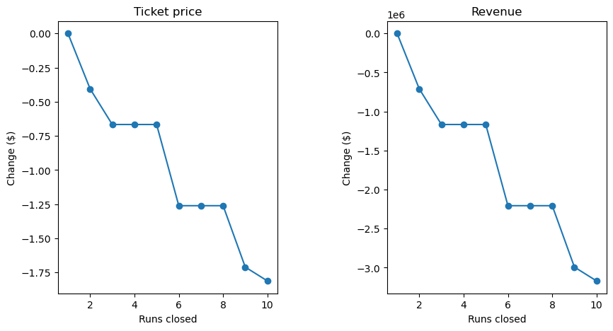
Model and Analysis
The resort can close to 6 runs without a large drop in revenue

Slide 7
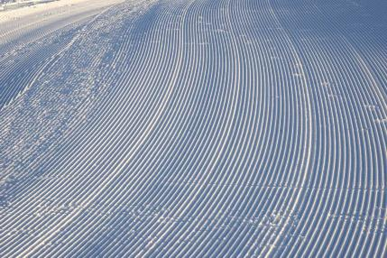
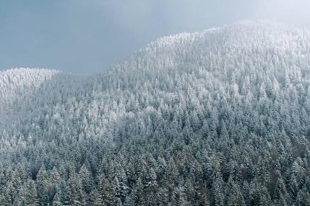
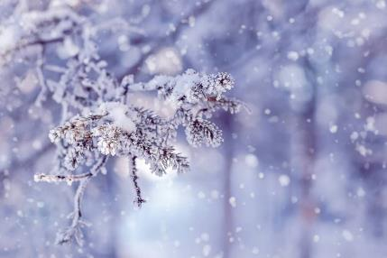
Conclusion
Big Mountain resort is a high-end resort with many significant facilities that are enjoyable by customers.
There might better resolutions to consider in order to increase revenue and still have the resort running for many more years to come.

Slide 8
Thank you
Any Questions?

